Slide 1
Tuesday January 28, 2014
Graph the following:
(Be sure to put all labels on the graph, and graph at least 2 points)
22.5 m/s

Slide 2
Wednesday January 29, 2014
How can you tell which object is traveling the fastest in a graph?
A
B
C

Slide 3
Thursday January 30, 2014
What is the person doing in the graph?
Distance (m)
Time (s)

Slide 4
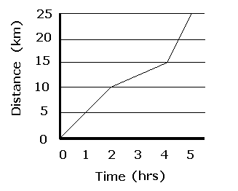
Friday January 31, 2014
What story is being told below?

