Slide 1
Tuesday February 11, 2014
Define force.

Slide 2
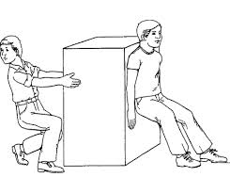
Wednesday February 12, 2014
Determine if the people below are applying a force that is a push or a pull.

Slide 3
Thursday February 13, 2014
How do you know if a force will change, start or stop the motion of an object? (*Hint think about net force)

Slide 4
Friday February 14, 2014
Find the net force of the forces applied to the box below (Be sure to use the proper label and show your work).
15N
23N

