Slide 1
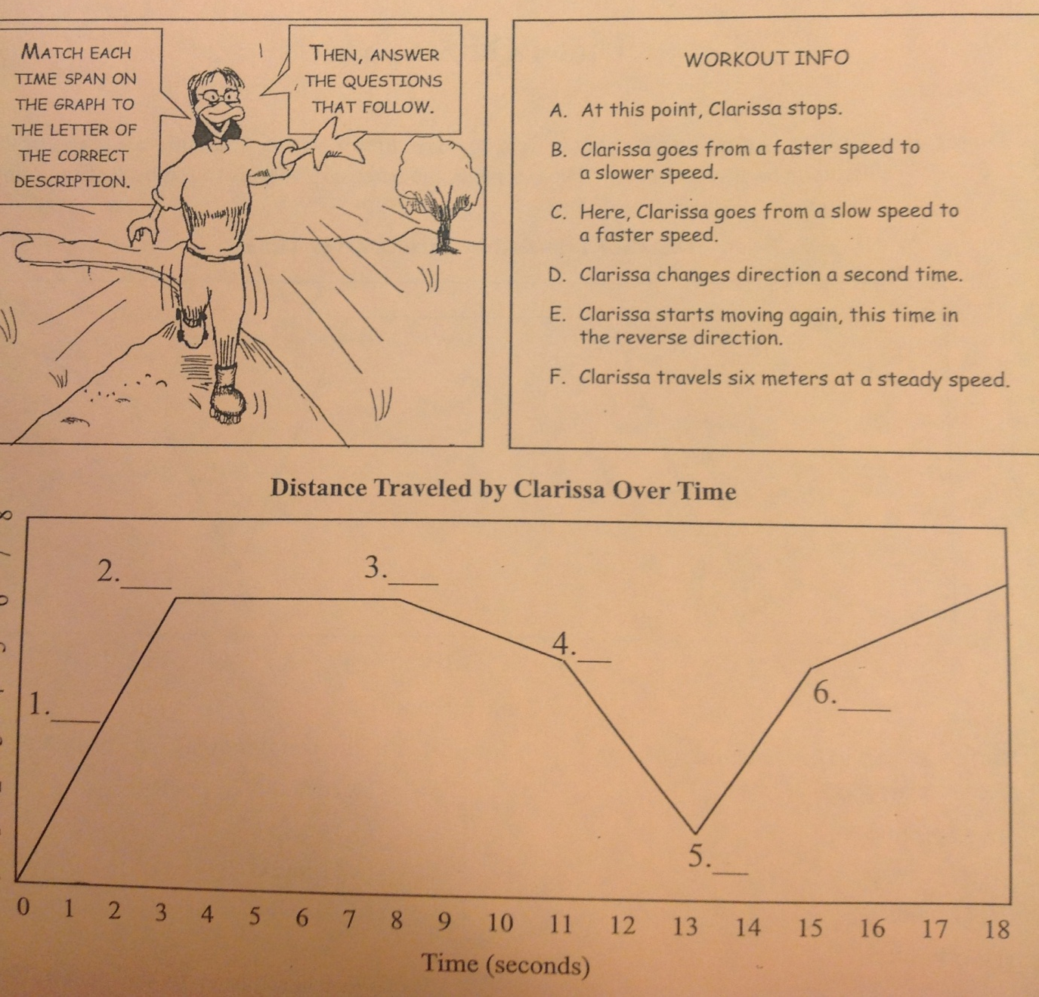
Monday February 3, 2014
Label the graph using the options in the box in the upper right corner.
B
D

Slide 2
Tuesday February 4, 2014
Using the graph given:
What is the slope of the line in the first 3 seconds?

Slide 3
Wednesday February 5, 2014
Using the graph below:
What is Clarissa’s speed between 3 and 8 seconds? How do you know?

Slide 4
Thursday February 6, 2014
Using the graph below:
When does Clarissa reverse direction while maintaining a constant speed?

