Slide 1
Earth Processes
Vocabulary
Click Below to start with a video – when the window opens be sure to click download

Slide 2
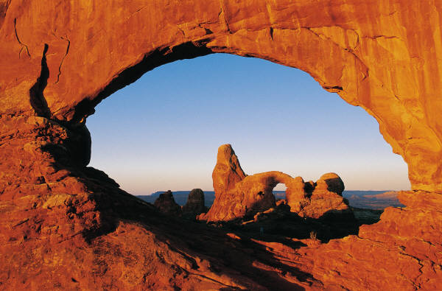
Abrasion
The grinding and wearing away of rock surfaces through the mechanical action of other rock or sand particles.

Slide 3
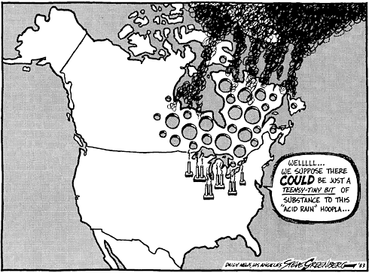
Acid rain
Rain containing acids that form in the atmosphere when industrial gas emissions (especially sulfur dioxide and nitrogen oxides) combine with water.

Slide 4
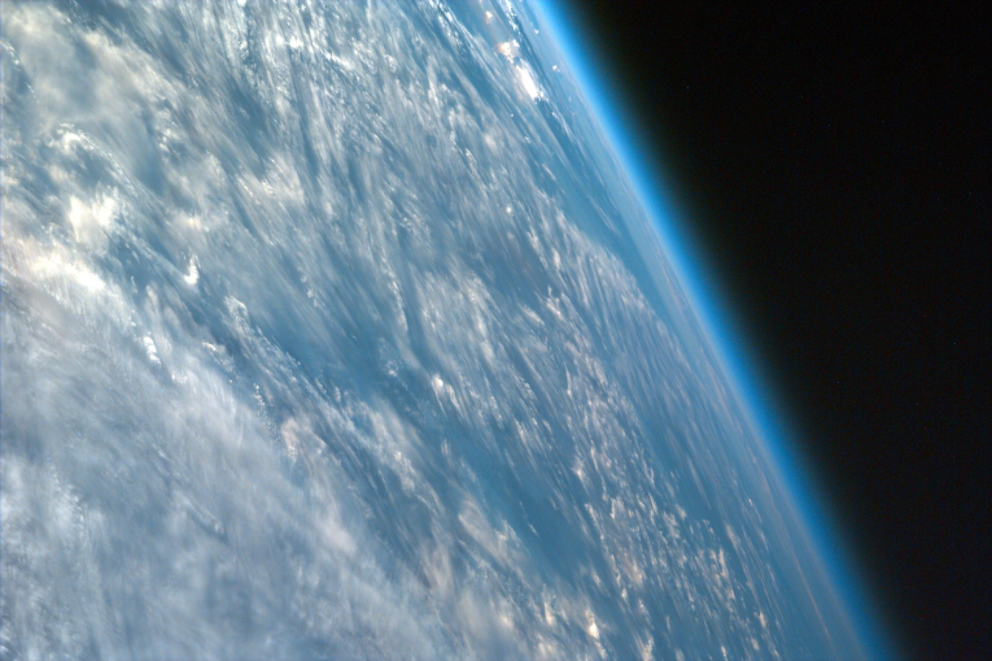
Atmosphere
The mixture of gases surrounding Earth and other planets.

Slide 5
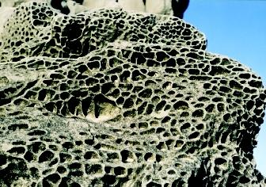
Chemical Weathering
Occurs when rock is exposed to water and air and is broken down or transformed into another material.

Slide 6
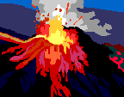
Constructive Process
Processes that build up landforms on Earth’s surface such as crust formation, volcanoes, and sediment deposition.

Slide 7
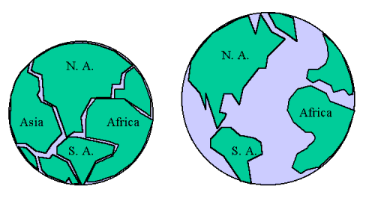
Continental Drift
The gradual movement of continents by tectonic plates under Earth’s surface which causes land masses to move toward or away from one another.

Slide 8
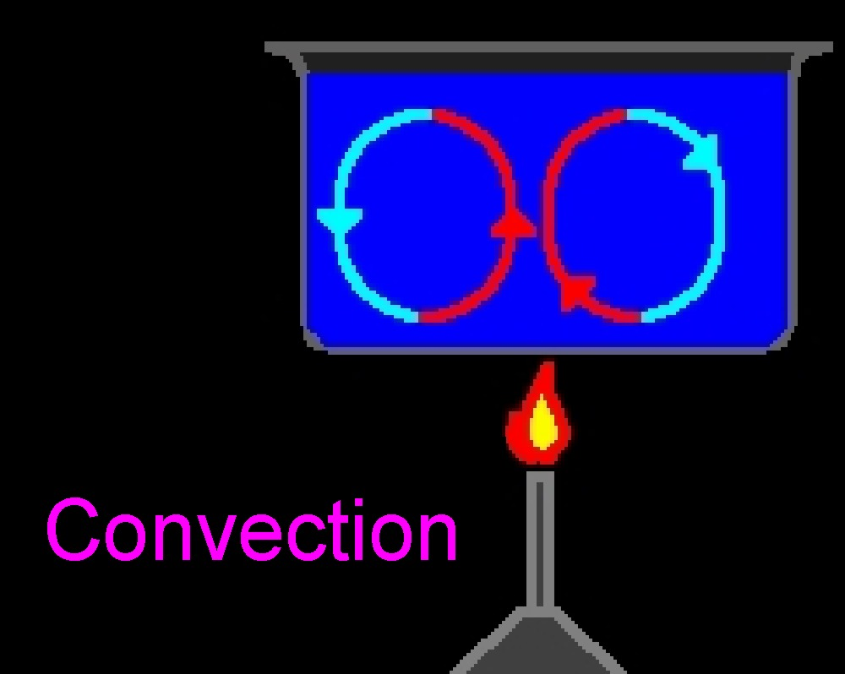
Convection
Heat transfer by moving particles in fluids, and the thermal energy that they carry.

Slide 9
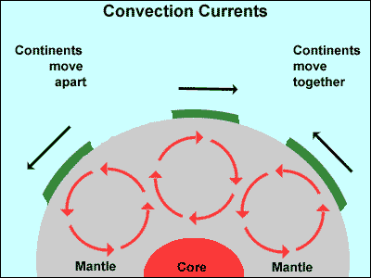
Convection Currents
A cyclical pattern of movement in a fluid body, driven by density variations and resulting from differences in temperature from one part to another

Slide 10
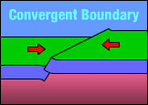
Convergent Boundary
Plate boundaries of Earth’s crust pushing together.
Click on the picture to play the animation of a convergent boundary

Slide 11
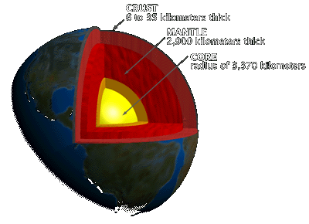
Crust
The upper part of the lithosphere, divided into oceanic crust and continental crust.
Click on the box to watch a video
When the window opens be sure to click download

Slide 12
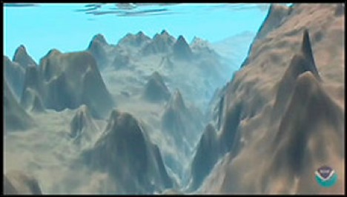
Deep Ocean Trench
A canyon in the ocean floor resulting from tectonic plate movement.

Slide 13
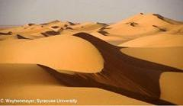
Deposition
When sediments are carried by wind or water and are deposited in a new location.

Slide 14
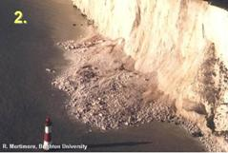
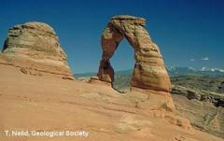
Destructive Process
Process that breaks down landforms on Earth’s surface such as weathering and erosion.

Slide 15
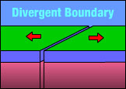
Divergent Boundary
When plate boundaries move away from each other.
Click on the picture to play the animation of a divergent boundary

Slide 16
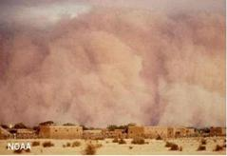
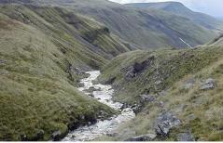
Erosion
A group of natural processes, including weathering, abrasion, corrosion, and transportation, by which material is worn away from Earth's surface.
Click the pictures below.

Slide 17
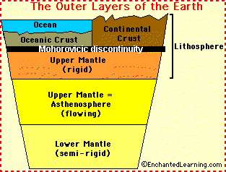
Lithosphere
The solid, outer layer of the Earth that consists of the crust and the upper part of the mantle.

Slide 18
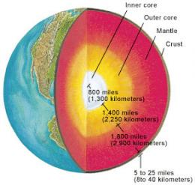
Mantle
The layer of hot rock between Earth's crust and core.

Slide 19
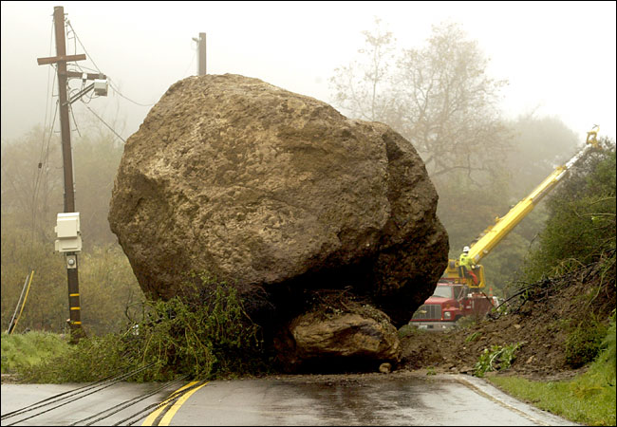
Mass Movement
The movement of any material, such as rock, soil or snow; down slope. Examples include: rock fall, landslide, and mudflows.

Slide 20
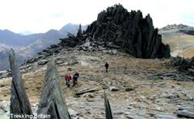
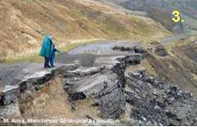
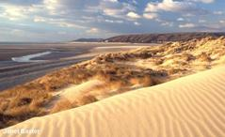
Mechanical Weathering
The breakdown of rock into smaller pieces by physical means. The forces that cause mechanical weathering are water, wind, ice, and gravity.
Click this link
ICE
GRAVITY
WIND
WATER

Slide 21
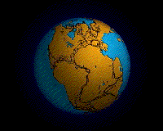
Pangea
Greek for “all earth”. The combination of all present continents in one single continent.

Slide 22
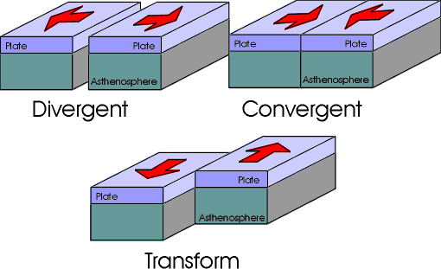
Plate Boundaries
The edges where two or more tectonic plates meet; may be convergent, divergent, or transform.

Slide 23
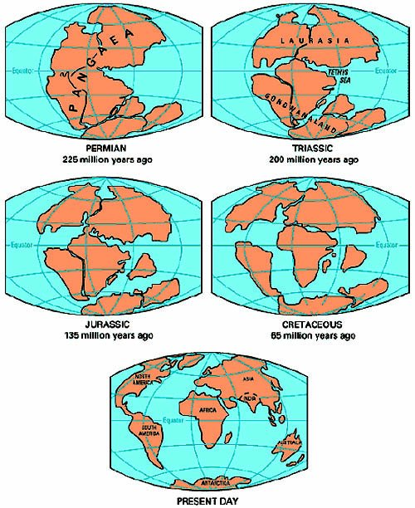
Plate Tectonics
The theory that the lithosphere is made up of about 30 large sections or plates which are in constant, very slow motion.

Slide 24
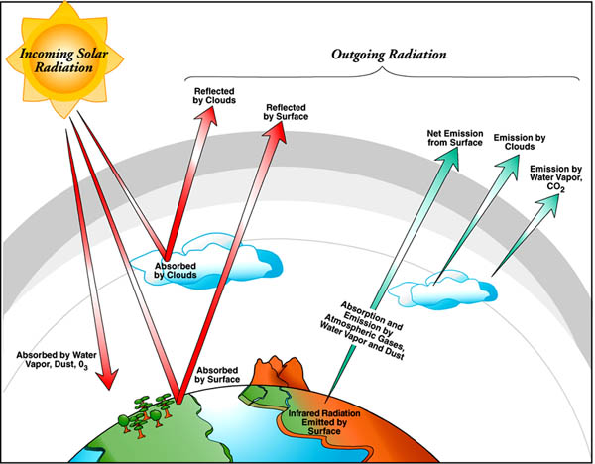
Radiation
Energy transfer without direct contact, as in the transport of heat from the sun to Earth.

Slide 25
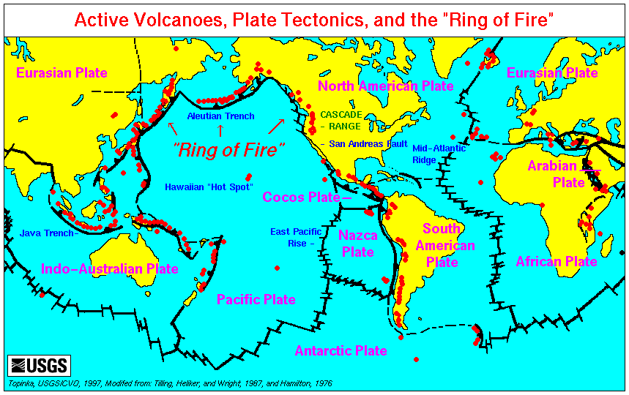
Ring of Fire
An area associated with plate boundaries around the Pacific Ocean that has a large amount of volcanic and earthquake activity.
Click on the picture to see where volcanic eruptions have been recorded on earth.

Slide 26
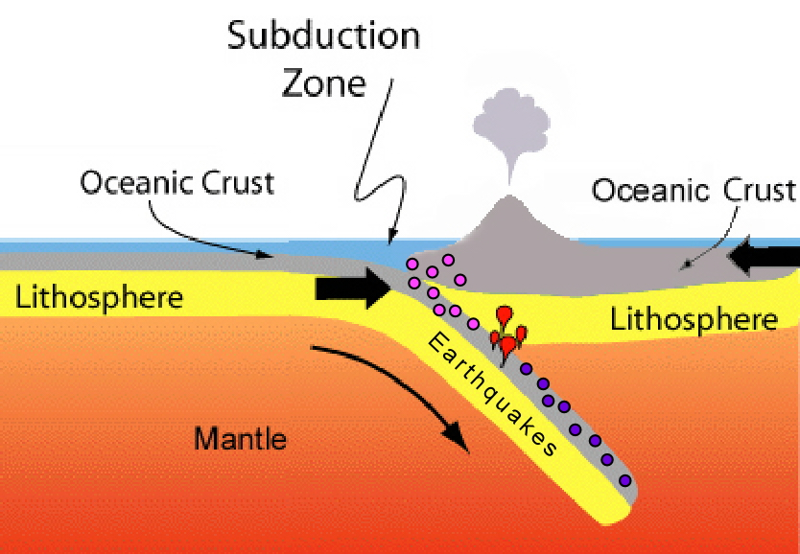
Subduction Zone
At a convergent boundary when one plate is subducted or sinks below the other plate.

Slide 27
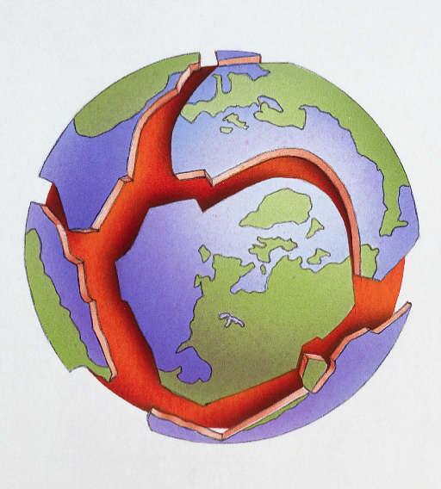
Tectonic Plate/ Lithospheric Plate
Extremely large pieces of lithosphere (Earth's crust).

Slide 28
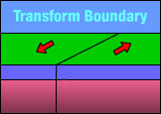
Transform Boundary
The boundary between tectonic plates that are sliding past each other horizontally.
Click on the picture to play the animation of a transform boundary

Slide 29
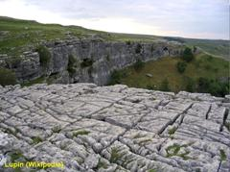
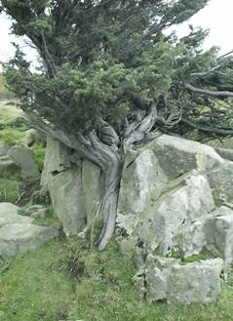
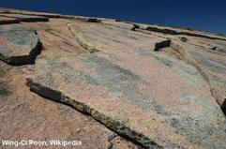
Weathering
The breakdown of rocks at the Earth’s surface, by the action of rainwater, extremes of temperature, and biological activity. It does not involve the removal of rock material. There are three types of weathering, physical, chemical and biological.
Click this picture to watch a video.
Chemical
Physical

