Slide 1
Environmental Science
Vocabulary

Slide 2
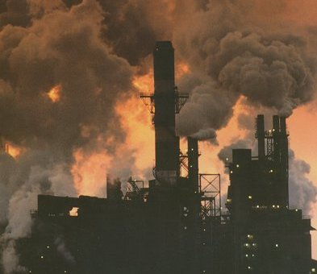
Air Pollution
The contamination of the atmosphere by the introduction of pollutants from human and natural resources.

Slide 3
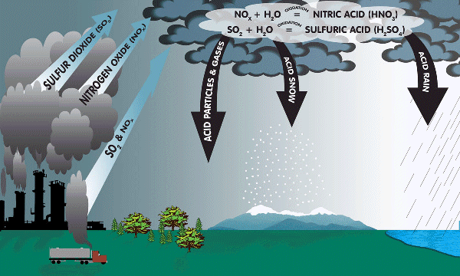
Acid Precipitation
Rain, sleet or snow containing acids that form in the atmosphere when industrial gas emissions combine with water

Slide 4
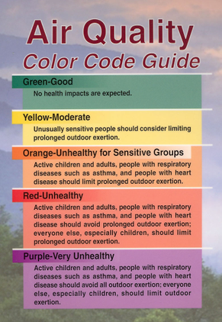
Air Quality
A measurement of the pollutants in the air; a description of healthiness and safety of the atmosphere

Slide 5
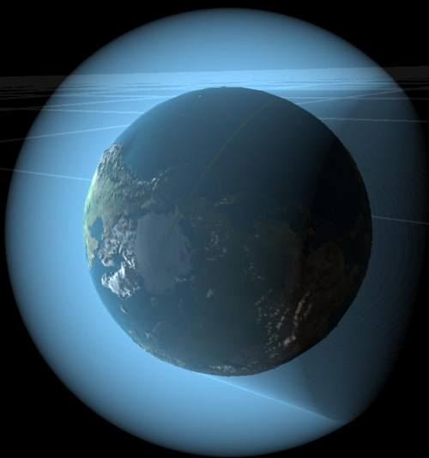
Atmosphere
The mixture of gases surrounding Earth and other planets

Slide 6
Benefit
Something that is good; an advantage.

Slide 7
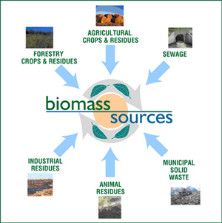
Biomass
Organic matter that can be a source of energy.

Slide 8
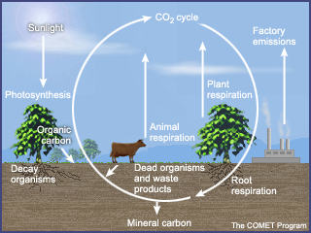
Carbon Cycle
The exchange of carbon between the environment and living things.

Slide 9
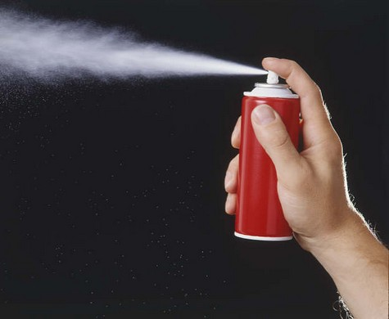
CFC - Chloroflorocarbon
Any of several compounds of carbon, fluorine, chlorine, and hydrogen:
Often used as refrigerants, foam-blowing agents, solvents, and as aerosol until scientists became concerned about the thinning of the ozone layer.

Slide 10
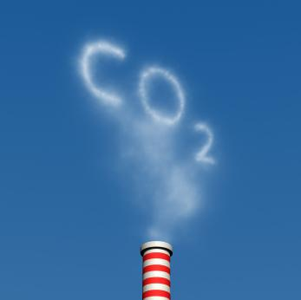
CO₂ – Carbon Dioxide
A colorless, odorless, incombustible gas. Carbon dioxide is present in the atmosphere and formed during respiration, usually obtained from coal or natural gas by combustion. Co2 is used in industry as dry ice, in carbonated beverages, fire extinguishers, etc.
CO2 Scrubber

Slide 11
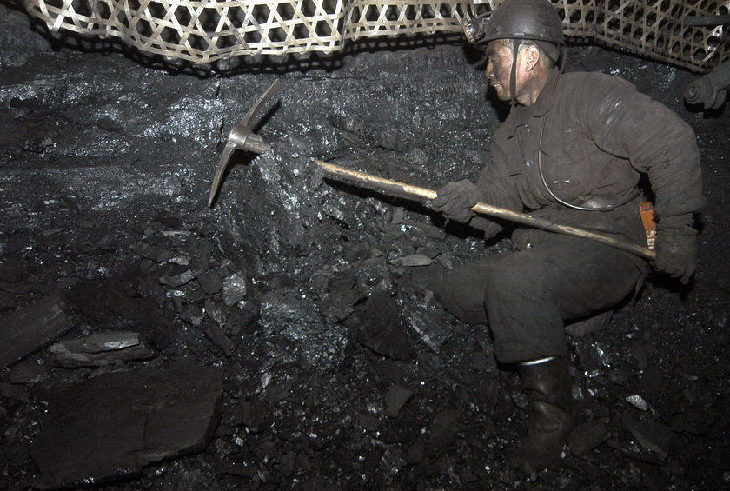
Coal
A fossil fuel that forms underground from partial decomposed plant material.

Slide 12
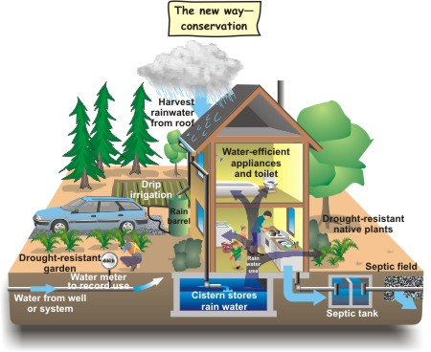
Conservation
The preservation and wise use of natural resources.

Slide 13
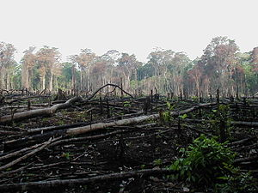
Deforestation
The clearing of forest lands.

Slide 14
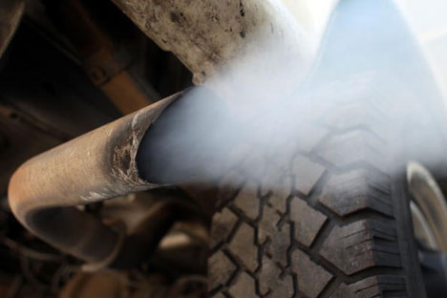
Emissions
Something that is discharged. Specifically referring to the exhaust from a car.

Slide 15
Energy Conservation
The practice of decreasing the quantity of energy used

Slide 16
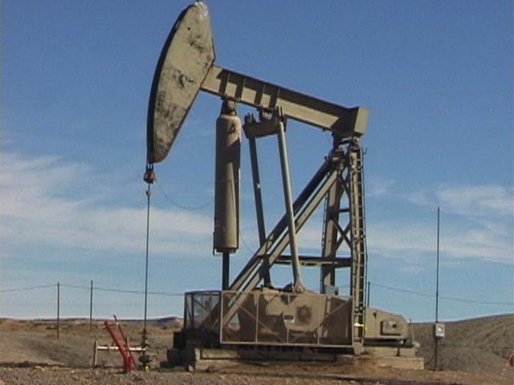
Fossil Fuel
A nonrenewable energy resource formed from the remains of organisms that lived long ago.
Examples
Coal, oil and
natural gas

Slide 17
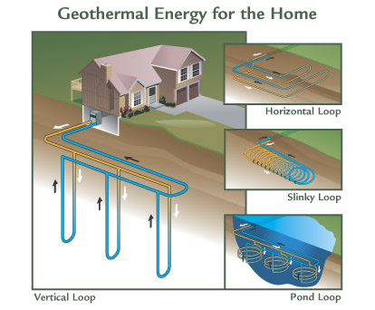
Geothermal Energy
The energy produced by heat within the Earth.

Slide 18
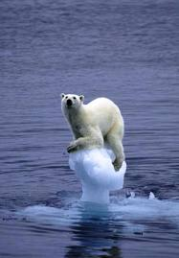
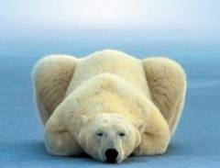
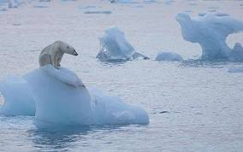
Global Warming
The warming of the Earth’s atmosphere causing the temperatures of the land and ocean to increase.
Click Here
http://epa.gov/climatechange/indicators/slideshow.html?placeValuesBeforeTB_=savedValues&TB_iframe=true&height=550&width=800

Slide 19
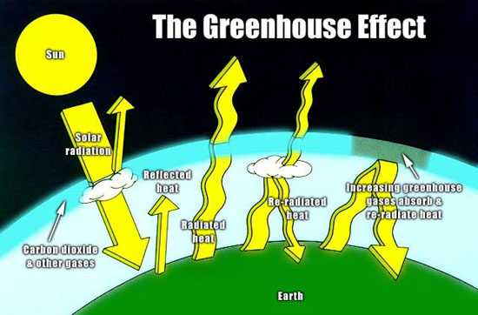
Greenhouse Effect
The process where thermal radiation from the Earth’s surface is absorbed by the Earth’s atmosphere’s greenhouse gases and is re-radiated in all directions.

Slide 20
Greenhouse Gases
Any of the gases whose absorption of solar radiation is responsible for the greenhouse effect, including carbon dioxide, methane, ozone, and the fluorocarbons.

Slide 21
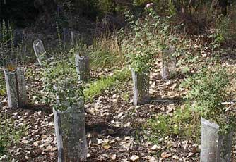
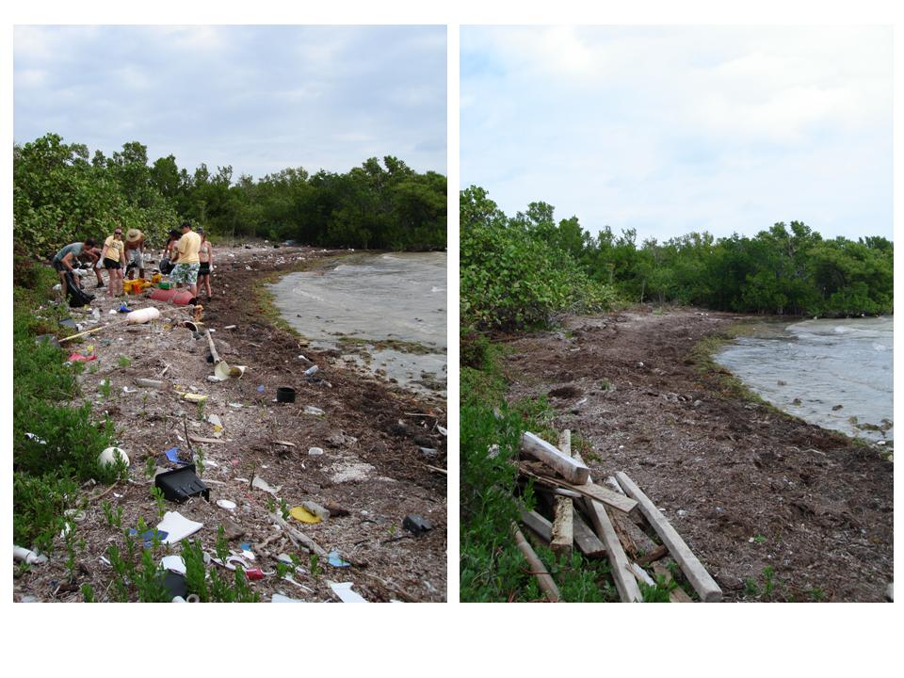
Habitat Restoration
The act, process, or result of returning a degraded or former habitat to a healthy, self-sustaining condition that resembles its pre-disturbed state.

Slide 22
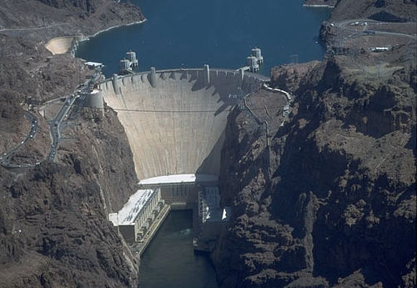
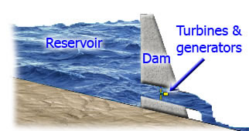
Hydroelectric Energy
Electrical energy produced by falling water.

Slide 23
Natural Gas
A mixture of gaseous hydrocarbons located under the surface of the Earth, often near petroleum deposits; used as fuel.

Slide 24
Natural Hazard
A naturally occurring event that will have a negative effect on people or the environment.

Slide 25
Natural Resource
Any natural material that is used by humans.
Examples:
Water, petroleum, minerals, forests and animals

Slide 26
Nonrenewable resources
A resource that forms at a rate that is much slower than the rate at which it is consumed.

Slide 27
Nuclear Energy
The energy released by a fission or fusion reaction; the binding energy of the atomic nucleus.

Slide 28
Overpopulation
The presence of too many individuals in an area for the available resources.

Slide 29
Ozone
layer in Earth's atmosphere which contains relatively high concentrations of ozone (O3).

Slide 30
Pesticides
Substances or mixture of substances intended for preventing, destroying, repelling or mitigating any pest.

Slide 31
Petroleum
A liquid mixture of complex hydrocarbon compounds; used widely as a fuel source.

Slide 32
Pollution
An unwanted change in the environment that is caused by harmful substances, wastes, gases, noise or radiation.

Slide 33
Recycling
The process of recovering valuable or useful materials from waste or scrap; the process of reusing some items.

Slide 34
Reforestation
The restocking of existing forests and woodlands which have been depleted.

Slide 35
Renewable Resources
A natural resource that can be replaced at the same rate at which the resource is consumed.

Slide 36
Risk
The potential that a chosen action or activity (including the choice of inaction) will lead to a loss (an undesirable outcome).

Slide 37
Runoff
Water on land that drains into a body of water

Slide 38
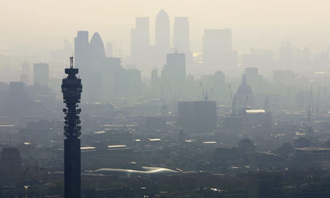
Smog
A photochemical haze that forms when sunlight acts on industrial pollutants and burning fuels.

Slide 39
Soil Erosion
Removal of soil by the agents of erosion.

Slide 40
Solar Energy
The energy received by the Earth from the sun in the form of radiation.

Slide 41
Urban Sprawl
The spreading outwards of a city and its suburbs to its outskirts, development of rural land.

Slide 42
Water Quality
The physical, chemical and biological characteristics of water. It is a measure of the condition of water relative to the requirements of any human need or purpose. It is most frequently used by reference to a set of standards against which compliance can be assessed.

Slide 43
Wind Energy
The use of a windmill to drive an electric generator.

